Slide 1

Major Project Phase-2 Review
12-05-2023
Error detection and Correction using Improved Redundant Matrix code
Under
B. Tech PROGRAM
By
Uppala Bhargava Sai (19071A04Q8)
Shaik Sajida (19071A04P6)
Gutta Karthikeya (19071A04K4)
Supervisor
Dr. G.Shanthi
Assistant Professor
Dept. of ECE
Department of Electronics and Communication Engineering
VNR Vignana Jyothi Institute of Engineering and Technology
(NAAC ‘A++’ Grade, Approved by UGC, NIRF(2022) 113 Rank.)
Pragathi Nagar, Nizampet (S.O)Hyderabad - 500 090

Slide 2
Outline of the Presentation
Abstract
Problem Statement
Motivation of the Proposed Work
Literature survey
Scope of the work
Objectives
Flow chart for encoding and decoding
Logical organization of information and redundant bits
Equations
Input parameters & Flow of process to identify and rectify erroneous bits
Error bit correction
Results, Conclusion & Future Scope
References

Slide 3
Abstract
Mobile way communication over the Internet requires error detection and correction. Error Control describes how networks handle and detect errors at the data link layer .
Each network connection is assumed to have two channels. One for data traffic and one for signaling and control. Robust error detection is encoded on the traffic channel based on the information bits and the correction code to form the transmitted data stream.
Currently, the error is tolerated by the SRAM memory frame, so Single Cell Upsets (SCU) or Multiple Cell Upsets (MCU) can occur. One of the main reasons for the MCU is the astronomical radiation.
The proposed technique is called Improved Redundant Matrix Code to protect SRAM-based memories from detuning of a large number of components.
The Improved Redundancy Matrix Code (IRMC) is used to detect the and troubleshoot storage devices. IRMC's detection rate and adjustments are in contrast to other rescue codes.
Space, power, and defer overhead is only . Results showed that IRMC has higher quality and higher correctability for MCU tuned for lower area, performance, and delay overhead than other evaluated codes.

Slide 4
Problem Statement
Some error detecting algorithms like CRC has drawback, is that they have only error detecting capabilities. They cannot correct for any errors in the data once detected at the destination, and the data must be transmitted again to receive the message.
The error detecting and correcting algorithms has major weakness in reducing redundancy, and managing the design with less power and delay characteristics.

Slide 5
Motivation of the Proposed Work
Error detection and correction are necessary in the mobile way communication through the internet. Error control describes how the network handles and detects errors in the data link layer.
A typical arrangement is the utilization of Error Correction Codes (ECC) in memory gadgets. When utilizing ECCs in information stockpiling, their encoding/decoding circuits must be productive regarding territory, power, and deferral.
The algorithm being used in this project is IRMC(Improved Redundant Matrix Code)
The Improved Redundant Matrix Code (IRMC) used to recognize and address errors in memory gadgets. The rate of discovery and adjustment of IRMC is contrasted with other redress codes, just as their region, power, and postpone overheads.

Slide 6
Literature survey
SN0 | Name of the journal | Name of the Author | Title of the paper | Key Findings
1. | In IEEE Access | R.Jenila, C. Supraja, C. Kanmani Pappa, N. Dharani | VLSI Implementation of Error Detection and Correction Codes for Space Engineering | To recover the data, again XOR operation was performed between the encoded bits and the recalculated encoded bits. After analyzing, verification, selection and correction process takes place.
2. | ICTACT Journal on Microelectronics | V. Bhanumathi and M. Sunandini | VLSI Architecture for Error Detection and Correction based on XOR | As technology is scaled down, MCUs become a more problematic one in SRAM memory, because MCUs flip the logical state in memory thereby affecting its reliability by introducing errors.
3. | Research Gate | Bao Liu | Error-detecting/correcting-code-based self-checked/corrected/timed circuits | propose a group of error-detecting/correcting-code(EDC/ECC)- based self-checked/corrected/timed circuits for logic robustness and performance scalability in nanoscale VLSI design

Slide 7
SNO | Name of the journal | Name of the Author | Title of the paper | Key Findings
4. | In ICRTCRET Journal | K. Kaviya Priya, Mr. M. Palaniappan | Implementation of Error Detection and Correction Codes using VLSI | It processed by adding an extra bit to each character. The bit is obstinate by a number of factors such as the type of parity and the data character has the number of logic-one bits
5. | In IEEE Transactions on Very Large Scale Integration (VLSI) Systems, vol. 27 | Rajeev Kumar Abhishek Gupta | VLSI Implementation of Block Error Correction Coding Techniques | For error correction and detection, several approaches are used. In information theory and coding techniques, error detection techniques provide a way for reliable communication instead of unreliable communication.
6. | The International journal of analytical and experimental modal analysis | PORALLA DIVYA U.GNANESHWARACHARY | Design and Implementation of VLSI and Architecture for Error Correction and Detection | The transmitter sends the Original data, and attaches a fixed number of parity bits, which are derived from the data bits by xor operation between three data bits to get one parity bit.

Slide 8
SNO | Name of the journal | Name of the Author | Title of the paper | Key Findings
7. | IEEE Transactions on Computers, Vol. XX | Hamed Farbeh, Hyeonggyu Kim | Maximizing Efficiency of Error Detection/Correction Codes in Associative Cache Memories | When configured to maximize the protection capability, EUC provides fourfold higher burst error detection/correction capability. Moreover, EUC is orthogonal to previous protection schemes and they can be redesigned based on the EUC architecture to further improve their efficiency.
8. | IEEE Access | Luis-J. Saiz-Adalid, Joaquín Gracia-Morán, J.-Carlos Baraza-Calvo | Ultrafast Codes for Multiple Adjacent Error Correction and Double Error Detection | ECC introduces encoding and decoding latencies, silicon area usage and power consumption. In other computer units, these parameters should be optimized, and redundancy would be less important.
9. | IEEE Transactions on Electromagnetic Compatibility | Jonas Van Waes, Jens Vankeirsbilck, Jonas Lannoo | Resilience of Error Correction Codes Against Harsh Electromagnetic Disturbances: Fault Elimination for Triplication-Based Error Correction Codes | It is found that a code with inversion is significantly more robust to these disturbances. Furthermore, a systematic fault injection is also performed to search for vulnerabilities within the code itself.

Slide 9
Scope of the work
The project initiated to implement the minute and major error detection and correction using IRMC with the help of Verilog which is hardware description language.
It is helpful in proper mobile way communication without any disturbance and also helpful in faster broadband and ethernet services.
It is helpful in reducing delay and power used by the system.

Slide 10
Objectives
Encoding the 32-bit and 64-bit code
Decoding the code if any error exists.
Analyzing simulation results of Message code in Xilinx tool
Comparing the delay and power of IRMC algorithm with other algorithms.

Slide 11
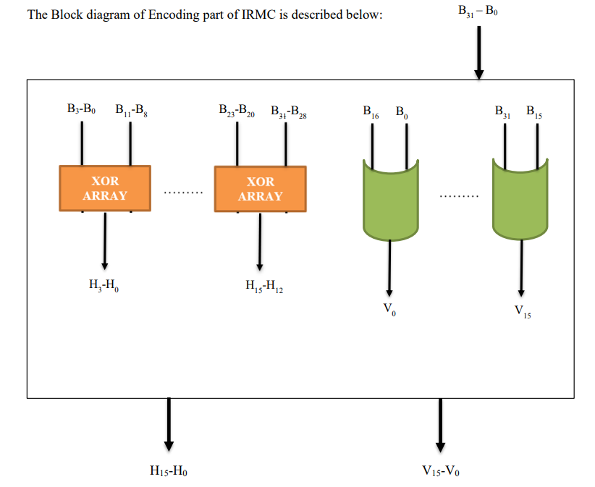
Block Diagram for Encoding

Slide 12
Terms used in Encoder
B₃₁ –B₀ : 32-bit Original input bit
H₁₅-H₀ : 16-bit Horizontal Redundant bits
V₁₅-V₀ : 16-bit Vertical Redundant bits

Slide 13
Encoder of IRMC Algorithm
To detect and fix faults that may happen during transmission or storage, an encoder of an error detection and correction code utilizing the improved redundant matrix code algorithm requires adding extra bits to the original message.
The procedure of developing a redundant matrix code that may be used to spot faults and pinpoint where in the message they are located.
A sophisticated error detection and correction method that can find and fix numerous faults in a message is the Improved Redundant Matrix Code Algorithm.
If an error occurs during transmission or storage, the receiver can utilize the parity check matrix to identify the kind and location of the fault. The parity bit can be used to fix errors that involve a single bit.
The Improved Redundant Matrix Code Algorithm-based Encoder of an Error Detection and Correction Code offers a very efficient way to find and fix problems in messages.
It is widely utilized in many different applications, such as digital media, data storage systems, and communication systems.

Slide 14
AXL Calculation for generation of redundant bits
The Additional Checksum for XOR-Like Functions is referred to as AXL in the encoder of an Error Detection and Correction code that uses the Enhanced Redundant Matrix Code Algorithm. It's a method for figuring out extra redundant bits that can be used for error prevention and rectification.
The various subsets of the input data bits are XORed together throughout the AXL computation process, and the results are then combined to produce the extra redundant bits.
The final AXL bits are created by combining the checksum values obtained after repeating this process for various subsets of bits. The original data bits are then combined with the AXL bits to form a new, larger block of data that may be delivered with better error detection and correction capabilities.
Overall, the Enhanced Redundant Matrix Code Algorithm benefits from the increased error detection and correction capabilities provided by the AXL calculation method, which can increase the precision and dependability of data transmission.

Slide 15
Logical organization of Information and Redundant bits
Original bit (32-bit) Horizontal Redundant (16-bit)
Vertical Redundant (16-bit)
B₁₅B₁₄B₁₃B₁₂ (S₃) | B₁₁B₁₀B₉B₈ (S₂) | B₇B₆B₅B₄ (S₁) | B₃B₂B₁B₀ (S₀) | H₇H₆H₅H₄ | H₃H₂H₁H₀
B₃₁B₃₀B₂₉B₂₈ (S₇) | B₂₇B₂₆B₂₅B₂₄ (S₆) | B₂₃B₂₂B₂₁B₂₀ (S₅) | B₁₉B₁₈B₁₇B₁₆ (S₄) | H₁₅H₁₄H₁₃H₁₂ | H₁₁H₁₀H₉H₈
V₁₅V₁₄V₁₃V₁₂ | V₁₁V₁₀V₉V₈ | V₇V₆V₅V₄ | V₃V₂V₁V₀ | ----- | ------

Slide 16
Block Diagram for Decoding
H
V
B^{e}
B^{e}₃-B^{e}₀
B^{e}₁₁-B^{e}₈
B^{e}₂₃-B^{e}₂₀
B^{e}₃₁-B^{e}₂₈
XOR
XOR
B^{e}₁₆
B^{e}₀
B^{e}₃₁
B^{e}₁₅
H₃-H₀
H^{e}₃-H^{e}₀
H₁₅-H₁₂
H^{e}₁₅-H^{e}₁₂
XOR
XOR
V₀
Ve₀
V₁₆
Ve₁₆
ERROR IDENTIFIER
NO
YES
S_{p}
S_{p}
FINAL SYNDROME
S_{p}
FAULT DETECTOR
S_{pm}
FAULT CORRECTOR(C)
C=S_{pm} XOR B^{e}

Slide 17
Terms used in Decoder
B → Original Input (consider 32-bit)
H → Horizontal redundant bits (16-bit)
V → Vertical redundant bits (16-bit)
B^{e} → Erroneous Input (32-bit)
H^{e} → Horizontal redundant bits for erroneous input (16-bit)
Ve → Vertical redundant bits for erroneous input (16-bit)
S_{p} →Syndrome value (16-bit)
S_{pm} → Updated syndrome value (32-bit)
C → Final modified output with no error bits (32-bit)

Slide 18
Decoder of IRMC Algorithm
A system created to decode a message that may have faults is called a decoder for an error detection and correction code utilizing the improved redundant matrix coding method.
To identify and fix mistakes in the received message, the decoder makes use of the parity check matrix created during the encoding procedure.
Using the parity check matrix created during the encoding phase, the received message is subjected to a parity check as the first step in the decoding procedure.
By comparing the received message to the encoded message, it is used to verify the message's integrity. If errors are found, they can be located and identified using the parity check matrix.
The decoder can fix a single-bit error by flipping the bit to the opposite value if one is found. The decoder might need to ask for the message to be sent again if there are several errors, or it could need to employ more sophisticated error-correction methods.
It offers a quick and easy way to identify and fix message mistakes, guaranteeing precise and dependable data transmission and storage.

Slide 19
Fault Detector
In order to find and fix faults that might have happened during data transmission, the fault detector in the decoder of an error detection and correction code is essential.
The decoder's fault detector then makes advantage of these extra redundant bits to identify any potentially corrupted bits and performs the proper correction methods to restore the original data.
Syndrome
The syndrome is a set of values that the decoder determines based on the received data and the redundant bits that were introduced during encoding in an Error Detection and Correction code that use the Improved Redundant Matrix Code Algorithm.
The syndrome is then applied to ascertain whether and, if so, where errors have occurred during transmission. The decoder applies a mathematical operation to the received data and redundant bits to determine the syndrome, usually by multiplying them by a predetermined matrix.
The decoder can employ a number of methods to fix errors if the symptoms suggest that they have happened. For instance, the decoder may flip a bit to fix an error if the syndrome indicates that a certain bit is incorrect.

Slide 20
Generations of Vertical Redundancy Bits and Horizontal Redundancy Bits
In the IRMC encoder, the algorithm starts with a parity matrix. When choosing the parity matrix, it is anything but difficult to decide the rationale conditions to figure out each parity and syndrome bit. For instance, the symbol 0 (B₀B₁B₂B₃) and symbol 2 (B₈B₉B₁₀B₁₁) apply to AXL calculation to produce the excess bits [H₃H₂H₁H₀]. The horizontal redundancy is computed.
V_{n} = B_{n} ^ B_{n+16} ; where n=number of bits
B₁₁B₁₀B₉B₈ ^ B₃B₂B₁B₀ = H₃H₂H₁H₀
B₁₅B₁₄B₁₃B₁₂ ^ B₇B₆B₅B₄ = H₇H₆H₅H₄
Memory decoding is fundamental for recovering the first word. The IRMC decodes the word in each row with all symbols. It recalculates the flat and vertical excess bits for Error detection. This IRMC technique in the setup word has a maximum error detection capability
Vertical Bits generation
Horizontal Bits generation

Slide 21
Cont’d...
Input Parameters & Flow of process to identify and rectify error bits
Consider,
B = 1111 0101 1010 1111 1111 0110 1010 1100 (31st bit to 0th bit)
Find horizontal & vertical parameters for input B
H = 0101 1010 0101 1010
V = 0000 0011 0000 0011
Consider, Erroneous input,
B^{e} = 1111 1101 1010 1101 1101 0100 0111 1100
Find horizontal & vertical parameters for B^{e}
H^{e} = 0101 0000 1010 1000
Ve = 0010 1001 1101 0001

Slide 22
Cont’d…
Flow of process to identify and rectify error bits
After obtaining H, H^{e}, V and Ve
Calculate H ^ H^{e}
If H ^ H^{e} ≠ 0 → error exist in B^{e}
Else H ^ H^{e} = 0 → no error
H ^ H^{e} = 0000 1010 1111 0010 (≠0)
Since, error exists, we need to calculate Syndrome (S_{p}).
S_{p} = V ^ Ve = 0010 1010 1101 0010
Using S_{pm}, we rectify the error to obtain errorless output using C = B^{e} ^ S_{pm.}

Slide 23
Error bit correction
31st bit
15th bit
0th bit
1 | 1 | 1 | 1 | 0 | 1 | 1 | 0 | 1 | 0 | 1 | 0 | 1 | 1 | 0 | 0
1 | 1 | 1 | 1 | 0 | 1 | 0 | 1 | 1 | 0 | 1 | 0 | 1 | 1 | 1 | 1
0 | 0 | 0 | 0 | 0 | 0 | 1 | 1 | 0 | 0 | 0 | 0 | 0 | 0 | 1 | 1
1 | 1 | 0 | 1 | 0 | 1 | 0 | 0 | 0 | 1 | 1 | 1 | 1 | 1 | 0 | 0
1 | 1 | 1 | 1 | 1 | 1 | 0 | 1 | 1 | 0 | 1 | 0 | 1 | 1 | 0 | 1
0 | 0 | 1 | 0 | 1 | 0 | 0 | 1 | 1 | 1 | 0 | 1 | 0 | 0 | 0 | 1
0 | 0 | 1 | 0 | 1 | 0 | 1 | 0 | 1 | 1 | 0 | 1 | 0 | 0 | 1 | 0
1 | 1 | 1 | 1 | 0 | 1 | 1 | 0 | 1 | 0 | 1 | 0 | 1 | 1 | 0 | 0
1 | 1 | 1 | 1 | 0 | 1 | 0 | 1 | 1 | 0 | 1 | 0 | 1 | 1 | 1 | 1
16th bit
B
V
B^{e}
Ve
S_{p}
C

Slide 24
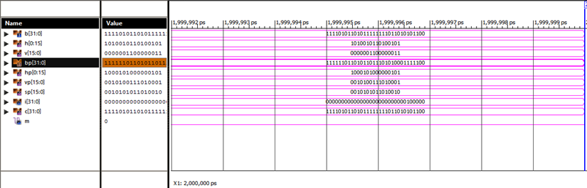
Simulation Result of 32-bit code:

Slide 25

Results: 32-Bit code
32-bit Design Report

Slide 26
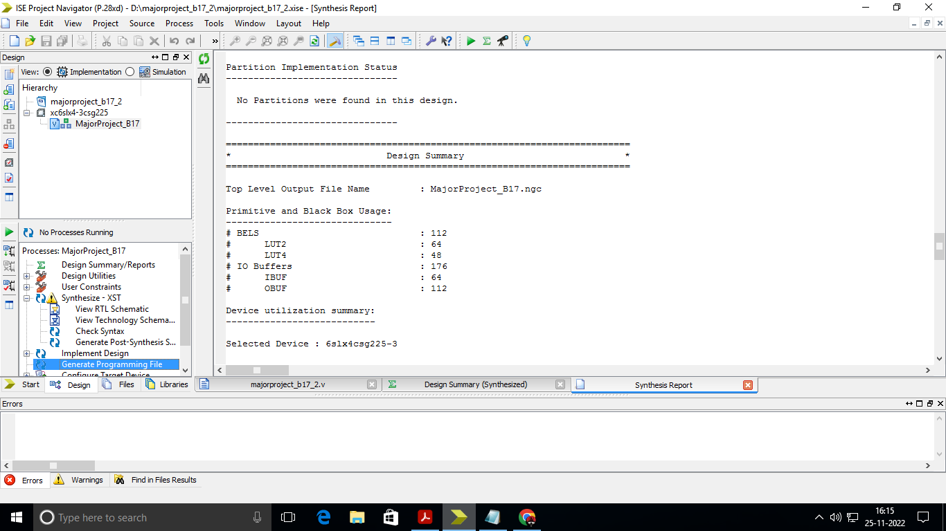
Design Summary:

Slide 27
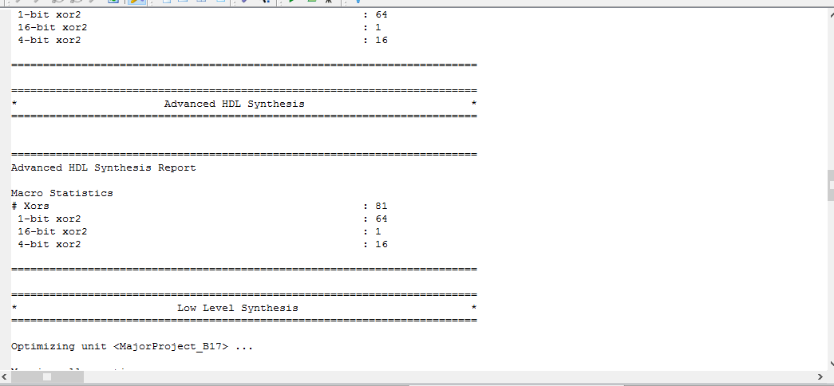

Slide 28
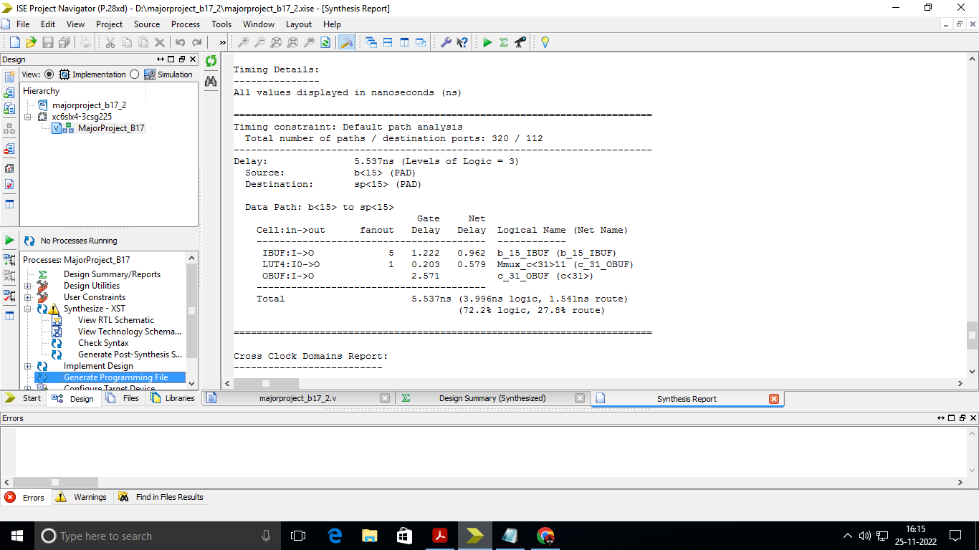
Timing Details:

Slide 29
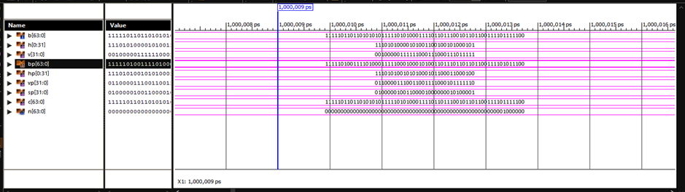
Simulation Result of 64-bit code:

Slide 30
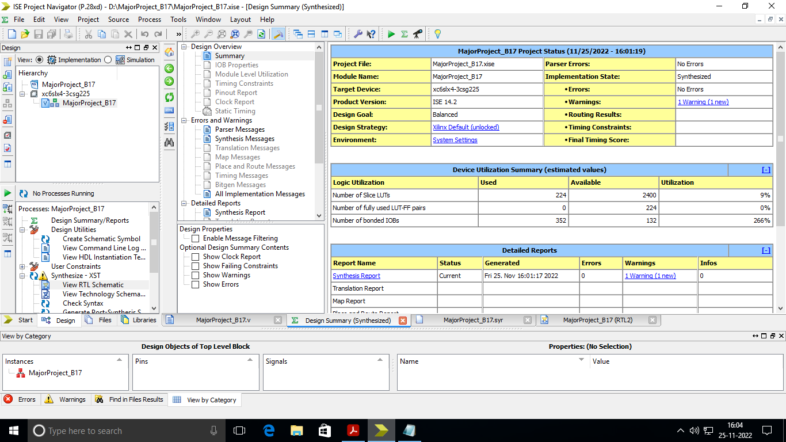
Results: 64-bit code
64-bit Design Report

Slide 31
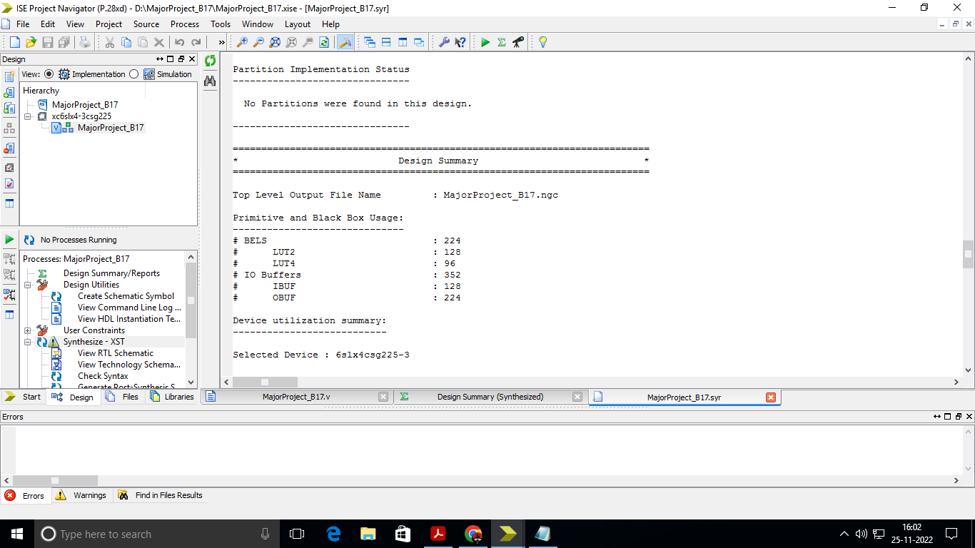
Design Summary:

Slide 32
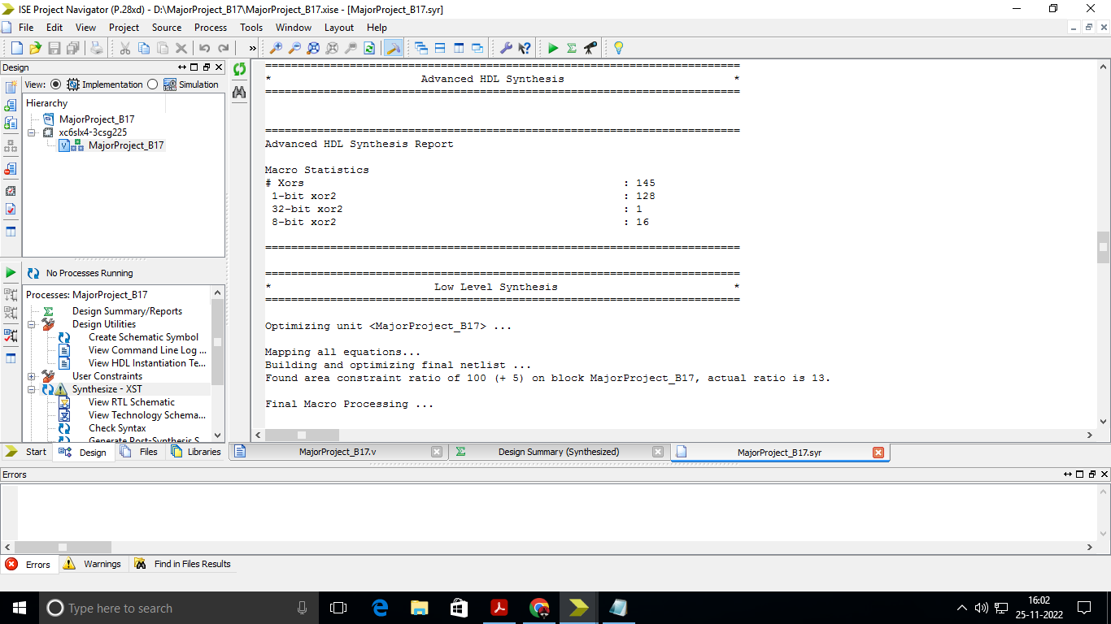

Slide 33
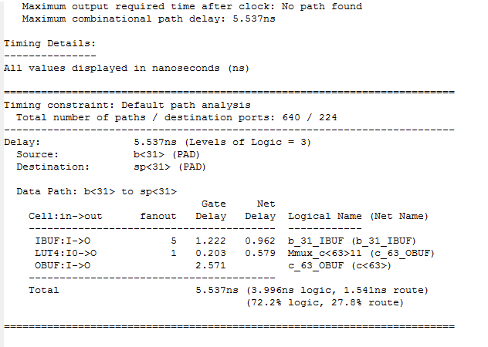
Timing Details:

Slide 34
Comparisons for 32-bit input code
Methods | Delay (ns) | Power (mW)
Reed-Muller Code ^{[1]} | 55ns | 264.8mW
Bit-Manipulation Algorithm ^{[10]} | 6.065ns | 327.3mW
Decimal Matrix Code ^{[9]} | 17.587ns | 121mW
IRMC (proposed) | 5.937ns | 38.903mW

Slide 35
Graphical Representation of comparison (32-bit)

Slide 36
Comparisons for 64-bit input code
Methods | Power ( in Watt or milliWatt) | Delay (nano seconds)
Decimal Matrix Code Algorithm^{[10]} | 330.8mW | 8.492ns
Bit Manipulation Algorithm^{[10]} | 330.7mW | 5.699ns
IRMC (proposed) | 68.7mW | 5.537ns

Slide 37
Graphical Representation of comparison (64-bit)

Slide 38
Conclusion and Future Scope
This project proposes with Data Segmentation Section Code which is an error detection and correction code for memory devices exposed to MCUs. By using this code on parity code and enclosed to handle more Multiple Cell Upsets.
The ECCs Matrix brought advantages in error coverage it increased heavily the cost of both codes when compared with Data Segment Section Code.
This work used a Matrix code to protect SRAM-based memories against multiple-bit upsets. Further, the Improved Redundant Matrix Code (IRMC) is used to detect and correct errors in memory devices.
The rate of error detection and correction of IRMC is compared to another correction code, as well as their area, power, and delay overheads, and the outcomes exhibited that the IRMC has high unwavering quality and high adjustment effectiveness for MCUs lined up with the low area, postponement, and power overhead than the other assessed codes.

Slide 39
References
[1] M. Priya and M. M. Vijay, "Error Detection and Correction for SRAM Systems Using Improved Redundant Matrix Code," 2019 International Conference on Recent Advances in Energy-efficient Computing and Communication (ICRAECC), Nagercoil, India, 2019, pp. 1-8, doi: 10.1109/ICRAECC43874.2019.8995121.
[2] R. Jenila, C. Supraja, C. K. Pappa and N. Dharani, "VLSI Implementation of Error Detection and Correction Codes for Space Engineering," 2021 Third International Conference on Intelligent Communication Technologies and Virtual Mobile Networks (ICICV), Tirunelveli, India, 2021, pp. 569-573, doi: 10.1109/ICICV50876.2021.9388477.
[3] B. Liu, "Error-detecting/correcting-code-based self-checked/corrected/timed circuits," 2010 NASA/ESA Conference on Adaptive Hardware and Systems, Anaheim, CA, USA, 2010, pp. 66-72, doi: 10.1109/AHS.2010.5546217.[5] Helia Naeimi and André DeHon (2009) ‘Fault Secure Encoder and Decoder for Nano Memory Applications’, IEEE Transactions on Very Large-Scale Integration (VLSI) Systems, Vol.17, No.4, pp. 473-486.
[4] K. Kaviya Priya, Mr. M. Palaniappan, “Implementation of Error Detection and Correction Codes using VLSI”, SSRG International Journal of Electronics and Communication Engineering ( SSRG – IJECE ) – Special Issue ICRTCRET Mar 2019.
[5] Zhang, X.. (2017). VLSI Architectures for Modern Error-Correcting Codes. 10.1201/b18673.
[6] P. Schulz, A. Traßl, A. N. Barreto and G. Fettweis, "Efficient and Reliable Wireless Communications via Multi-Connectivity Using Rateless Codes in Single- and Multi-User Scenarios," in IEEE Transactions on Wireless Communications, vol. 20, no. 9, pp. 5714-5729, Sept. 2021, doi: 10.1109/TWC.2021.3069669.
[7] F. M. Hashemian, M. Shivaie, and A. Daneshtalab, "A Low-Complexity and High-Performance Error Correction Code for Non-Volatile Memories," IEEE Transactions on Very Large Scale Integration (VLSI) Systems, vol. 27, no. 10, pp. 2225-2236, Oct. 2019.

Slide 40
References
[8] Y. Chen, H. Zhang, Y. Song, and D. Chen, "Low-Latency Polar Codes for HARQ Feedback in 5G Systems," IEEE Transactions on Vehicular Technology, vol. 68, no. 6, pp. 5641-5645, Jun. 2019.
[9] E. Abinaya, Dr. D. Somasundareswari, S. Mathan Prasad (2015) ‘Error Detection and Correction in 32-bit SRAM based FPGA memory using Decimal Matrix Code’, International Journal of Science Technology & Management, Vol.04, No.1, pp. 2394-1529.
[10] V. Bhanumathi, M. Sunandini (2019) ‘VLSI Architecture for error detection and correction based on XOR against multiple cell upsets with reduced redundant bits’, ICTACT Journal of Microelectronics, Vol.05, No.2, pp. 2395-1680.
[11] V. Yatskiv, S. Kulyna, P. Bykovyy, T. Maksymyuk and A. Sachenko, "Method of Reliable Data Storage Based on Redundant Residue Number System," 2020 IEEE 5th International Symposium on Smart and Wireless Systems within the Conferences on Intelligent Data Acquisition and Advanced Computing Systems (IDAACS-SWS), Dortmund, Germany, 2020, pp. 1-4, doi: 10.1109/IDAACS-SWS50031.2020.9297052.
[12] T. P. Le, P. H. Trong, and T. Q. Dang, "High-Throughput Syndrome-Based Error Correction Codes for NAND Flash Memory," IEEE Transactions on Very Large Scale Integration (VLSI) Systems, vol. 28, no. 9, pp. 2116-2120, Sep. 2020.
[13] H. Heidarzadeh, S. E. Salami, and H. F. Rashvand, "Optimized Polar Codes for Beyond-5G Terahertz Communication Systems," IEEE Transactions on Communications, vol. 68, no. 2, pp. 1186-1195, Feb. 2020.
[14] T. Wang, H. Liu, J. Lin, and C. Wang, "An Efficient and Low-Complexity Error Correction Scheme for Non-Volatile Memory," IEEE Transactions on Very Large Scale Integration (VLSI) Systems, vol. 28, no. 5, pp. 1139-1143, May 2020.
[15] J. Zhou, Z. Liu, and Y. Li, "An Efficient Algorithm for Low-Density Parity-Check Codes Based on Min-Sum Message-Passing," IEEE Transactions on Communications, vol. 67, no. 6, pp. 4224-4234, Jun. 2019.
[16] M. Xiao, M. Liu, H. Li, and Y. Li, "Polar Codes for Channel Coding in DNA Storage Systems," IEEE Transactions on Nanobioscience, vol. 19, no. 2, pp. 179-186, Jun. 2020.

Slide 41
Thankyou

